Slide 1

Unit 1: Lesson 3
Time management
U ovoj ćeš lekciji ponoviti sadašnje glagolsko vrijeme present simple.

Slide 2
Open your book, page 16.
Task 1: Are you a well-organized person? Do the quiz and find out.
snooze button = gumb za odgodu alarma
curled up = zgužvan
a banana peel = kora banane
due date = krajnji rok
to pull and all-nighter = raditi cijelu noć
to highlight = označiti, istaknuti
scribble = šarati, škrabati
assignment = zadatak

Slide 3
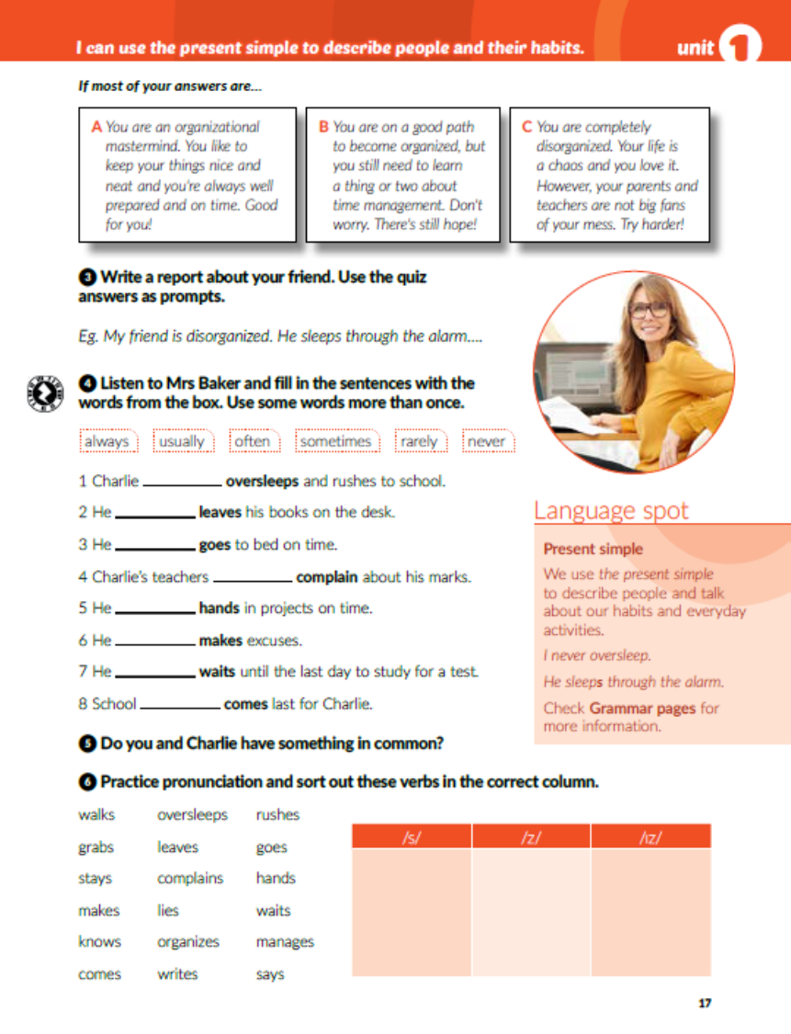
Task 2: Check your results.
Task 3: Write a report.
E.g.
I am very disorganized. I always sleep through the alarm and I am often late for school. My backpack is in a mess. When my teacher assigns a project I wait for the due date and then realize I left my books at my friend’s place. When I take notes at school I usually scribble on a piece of paper I’ve borrowed from my classmate. I keep all my assignments in my head and usually forget half of them. Also, I never know where my house key is.

Slide 4
Task 4: Listen to Mrs Baker and fill in the sentences with the words from the box.
https://www.e-sfera.hr/dodatni-digitalni-sadrzaji/f71282b8-8844-45db-af07-425849b5ed3f/
Present simple tvorimo tako da na osnovu glagola dodamo nastavak s/es u 3. licu jednine.
Npr. I/you/we/they collect stickers.
He/she/it collects stickers.
Present simple je sadašnje glagolsko vrijeme koje upotrebljavamo kada opisujemo ljude i govorimo o svojim svakodnevnim aktivnostima i navikama.
often
usually
never
sometimes
rarely
always
usually
always

Slide 5
Task 6: Practice pronunciation and sort out these verbs in the correct column.
walks
makes
oversleeps
writes
waits
grabs
stays
knows
comes
leaves
complains
lies
goes
hands
says
organizes
rushes
manages

Slide 6
Task 1: Complete the text with the present simple form of the verbs in the box
get
brush
wash
get
come
makes
are
walk
have
rushes
grabs
come
feel
take
throws
shouts
gets
sees
join
eat
go
put
stop
goes
meet
hang
chat
stay
makes
binge-watch
order
hates

Slide 7
Task 2: Make the sentences true by using don’t or doesn’t.
Diane’s mum doesn’t make delicious pancakes.
Diane and her friends don’t take the bus to school.
They don’t have lunch in the schoolyard.
They don’t hang around the playground until five.
Diane’s mum doesn’t feel calm when she sees Diane sleeping during the day.
Alice and Diane don’t go to the cinema at weekends.

Slide 8
Task 3: Unsramble the questions and match them to the answers.
5
7
When does the lunch break start?
Where do they usually sit at lunch?
4
What do they usually have for lunch?
7
Does Diane go to the drama class?
2
Does Diane take a nap after school?
6
3
Why is she tired in the morning?
Where do Diane and Alice sometimes go at weekends?

Slide 9
Task 4: What advice would you give Diana to make her daily routine more interesting?
Task 5: Circle the correct option.

Slide 10
Task 6: Complete the sentences using the adverbs of frequency.
Task 7: Rewrite the sentences using the time expressions in brackets.
Michelle and Ben go skiing in the Alps every winter.
They always feel hungry after the chicken nuggets commercial.
Robert is sometimes bored in the evening.
Jane tutors her cousin maths twice a week.
My grandparents and their neighbours often play chess.
I take my dog for a walk every morning.

Slide 11

Otvori sljedeće poveznice, te odaberi PLAY AND LEARN!
https://wordwall.net/play/18514/318/638

